Slide 1
β-Cyclodextrin: A Green and Efficient Supramolecular Catalyst for Synthesis of Thioamide Derivatives
Presented by
Mr. Yogesh A. Tayade

Slide 2
What is Supramolecular Chemistry ?

Slide 3
β-Cyclodextrin: Supramolecular Catalyst
Figure 1 Structure of β-cyclodextrin

Slide 4
Abstract:
Supramolecular catalyst β-Cyclodextrin (β-CD) and water mediated simple protocol for the synthesis of thioamide derivatives has been developed based on a one-pot multicomponent reaction between substituted aldehydes, Sulfur powder and secondary amines morpholine, piperidine and pyrrolidine respectively in presence of water at 100 ºC.

Slide 5
Introduction
The thioamide functional group is commonly found in biologically active compounds and antithyroid drugs. Thioamides are prevalent organic motifs found in vital biological and pharmaceutical molecules, such as closthioamide, hydroxymethyl thiolactam cyclothialidine, and Ncyclohexylethyl-ETAsV, etc. (Figure 2).
Figure 2 Representative bioactive thioamide scaffolds

Slide 6
Review of Literature
The synthesis of thioamide derivatives have been reported in the literature involving Sulfated tungstate,⁴ various methods reported from nitrile to thioamide involving thioacetic acid in presence of calcium hydroxide⁵, gaseous H₂S in presence of anion-exchange resin (Dowex 1X8, SH– form)⁶, microwave assisted solvent free synthesis⁷ NaSH and MgCl₂ ^{in} DMF⁸ sodium hydrogen sulfide and diethylamine⁹. Thioamide derivatives from arylaldoxime by using TiCl₃OTf with 1-butyl-3-methylimidazolium bromide¹¹, thiophosphoryl chloride,¹² and thioamide also synthesize from benzoic acid¹³. Some other method has been also reported for the synthesis of thioamide derivatives are shown below.
Conventionally, Lawesson’s reagent and its analogues are applied to the synthesis of thioamides (Scheme 1).¹⁴
Scheme 1

Slide 7
C. Oliver Kappe, et. al. (2003)
C. Oliver Kappe, et. al. (2003) reported synthesis of thioamide derivatives via kindler reaction with three-component condensations of aldehydes, amines, and elemental sulfur were carried out using 1-methyl-2-pyrrolidone (NMP) as solvent employing microwave flash heating at 110-180 °C for 2-20 min (Scheme 2).
Scheme 2
Ali Al-Mourabit et. al. (2012)
Ali Al-Mourabit et. al. developed an efficient and selective multicomponent oxidative coupling of two different aliphatic primary amines into thioamides by elemental sulfur under solvent-free conditions (Scheme 3).
Scheme 3

Slide 8
Hye-Young Jang, et. al. (2014)
Hye-Young Jang, et. al develop an environmentally friendly oxidation method that affords the direct conversion of thiols to thioamides without the use of exogenous sulfur reagents (Scheme 4) .
Scheme 4
Xuefeng Jiang, et. al. (2016)
Xuefeng Jiang, et. al. developed an efficient aqueous synthesis of thioamides through aldehydes, sodium sulfide, and N-substituted formamides (Scheme 5).
Scheme 5

Slide 9
Renhua Qiu, et al. (2016)
Renhua Qiu, et al. reported thioamides derivatives at 100 °C in high yield through the reaction of 1,2-dibenzyldisulfane
with difurfuryldisulfide using iodine as oxidant and DMSO as solvent (Scheme 5).
Scheme 5
Scheme 6

Slide 10
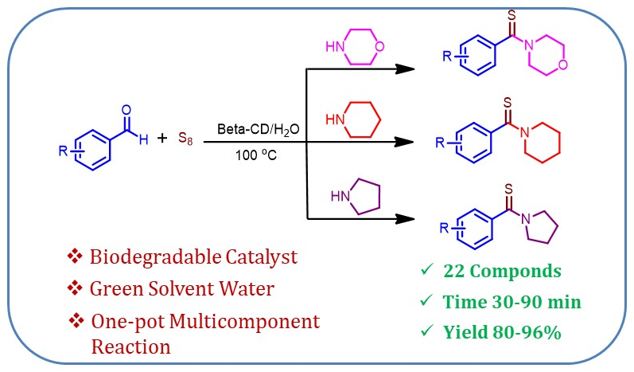
Present Work
Scheme 7 General scheme for the synthesis of thioamide derivatives

Slide 11
Table 1 Study of the effect of temperature on reaction time and yields for the synthesis of morpholino(phenyl)methanethione ª
Entry | Temp (ºC) | Time (hr/min) | Yield^{b} (%)
1 | RT | 12 hr | trace
2 | 40 | 12 hr | 20
3 | 60 | 12 hr | 40
4 | 80 | 03 hr | 80
5 | 100 | 30 min | 92
ª Reaction conditions: benzaldehyde (2 mmol), morpholine (2 mmol), sulfur powder (4 mmol), β-CD (20 mol %) and water (10 mL). ^{b} Isolated yield.

Slide 12
Table 2 Optimization of reaction using different amounts of catalyst for the synthesis of morpholino(phenyl)methanethione at 100 ºC in waterª
Entry | Catalyst | Time (min) | Yield^{b} (%)
1 | -- | 180 min | 60
2 | β-CD (5 mol %) | 120 min | 80
3 | β-CD (10 mol %) | 60 min | 84
4 | β-CD (15 mol %) | 60 min | 88
5 | β-CD (20 mol %) | 30 min | 92
6 | β-CD (25 mol %) | 30 min | 92
ª Reaction conditions: benzaldehyde (2 mmol), morpholine (2 mmol), Sulfur powder (4 mmol), catalyst (20 mol %), H₂O (10 mL) at 100 ⁰C. ^{b} Isolated yield.

Slide 13
Table 4 Synthesis of various thioamide derivatives in presence of β-CD at 100 ºC
4 a-i
4 j-p
4 q-v

Slide 16
Inclusion Complex Study
Figure 3 a) Structure of β-Cyclodextrin and b) Inclusion complex of
β-Cyclodextrin with 4-cyanobenzaldehyde.
Table 5 400 MHz ¹H-NMR chemical shifts of β-CD protons in the free and inclusion complex in D₂Oª
Figure 4 ¹H-NMR of spectra (a) β-CD and (b) β-CD-4-cyanobenzaldehyde inclusion complex
Proton | H1 | H2 | H3 | H4 | H5 | H6a,b
β-CD | 5.0021 | 3.5815 | 3.8959 | 3.5154 | 3.7886 | 3.8094
Complex | 4.9940 | 3.5743 | 3.8482 | 3.5107 | 3.7204 | 3.8032
∆δ | 0.0081 | 0.0072 | 0.0477 | 0.0047 | 0.0682 | 0.0062

Slide 17
Catalyst recovery
The catalyst recovery and reusability were studied by three cycles including the use of fresh catalyst for the synthesis of morpholino(phenyl)methanethione (Table 4, entry 4a). In every cycle, the catalyst was almost quantitatively recovered and after second and third use of catalyst decreasing yield is not much more significant which is shown in Figure 3.
Figure 5 Catalyst recovery study

Slide 18
Spectral Data
¹H NMR of 4-(morpholine-4-carbonothioyl) benzonitrile
¹H NMR (CDCl3, 400 MHz, ppm) δ: 7.64 (2H, d, J = 8.06 Hz), 7.36 (2H, d, J = 8.36 Hz), 4.33 (2H, t, J = 5.46 Hz), 3.46 (2H, t, J = 5.64 Hz), 1.85-1.73 (4H, m), 1.60-1.54 (2H, m).

Slide 19
¹³C NMR 4-(morpholine-4-carbonothioyl) benzonitrile
¹³C NMR (CDCl3, 100 MHz, ppm) δ: 196.41, 147.20, 132.44, 126.07, 118.33, 111.86, 53.28, 50.36, 26.86, 25.41, 23.99.

Slide 20
Mass of 4-(morpholine-4-carbonothioyl) benzonitrile
MS (ESI) m/z: 233 [M+1]

Slide 21
Conclusion
In conclusion, we have developed a very simple, facile and conveniently practical method for easy access of thioamide derivatives.
β-cyclodextrin is environmentally benign, non-toxic and reusable catalyst for a one-pot multicomponent reaction in water for thioamide synthesis.
The prominent advantages of this method are mild reaction conditions, shorter reaction times, good to excellent yields, easy recovery as well as reuse of catalyst.
Meanwhile, the reusability of biodegradable β-cyclodextrin and green solvent water are the key advantages of present method.

Slide 22
References:
Downer, N. K.; Jackson, Y. A. Org. Biomol. Chem. 2004, 2, 3039.
Inoue, Y.; Kanbara, T.; Yamamoto, T. Tetrahedron Lett. 2003, 44, 5167.
Bartlett, P. A.; Spear, K. L.; Jacobsen, N. E. Biochemistry, 1982, 21(7), 1608.
Lincke, T.; Behnken, S.; Ishida, K.; Roth, M.; Hertweck, C. Angew. Chem., Int. Ed. 2010, 49, 2011.
Pathare, S. P.; Pramod S. Chaudhari, P. S.; Akamanchi, K. G. Applied Catalysis A: General 2012, 425-426, 125.
Mahammed, K. A.; Jayashankara, V. P.; Premsai Rai, N.; Mohana Raju, K.; Arunachalam, P. N. Synlett 2009, 14, 2338.
Liboska, R.; Daniel Zyka, D.; Miroslav Bobek, M. Synthesis 2002, 12, 1649.
Moghaddam, F. M.; Hojabri, L.; Dohendou, M. Synth. Commun. 2003, 33, 4279.
Manaka, A.; Sato, M. Synth. Commun. 2005, 35, 761.
Boys, M. L.; Downs, V. L. Synth. Commun. 2006, 36, 295.
Aghapoor, K.; Mohsenzadeh, F.; Khanalizadeh, G.; Darabi, H. R. Monatshefte fur Chemie 2007, 138, 61.
Noei, J.; Khosropour, A. R. Tetrahedron Lett. 2008, 49, 6969.
Pandey, L. K.; Pathak, U.; Mathur, S.; Suryanarayana, M. V. S. Synthesis 2012, 44, 377.
Fazylov, S. D.; Nurkenov, O. A.; Akhmetkarimova, Zh. S.; Zhienbaeva, D. R. Russian Journal of General Chemistry 2012, 82, 781.
Xi Wang, Ji, M.; Lim, S.; Hye-Young Jang. J. Org. Chem. 2014, 79, 7256.
Wei, J.; Li, Y.; Jiang, X. Org. Lett. 2016, 18, 340.
Chen, S.; You Li, Y.; Chen, J.; Xu, X.; Su, L.; Zhi Tang, Z.; Chak-Tong, Au.; Renhua Qiu, R. Synlett 2016, 27.

Slide 23
Thank You

